Slide 1
Photo Fundraiser to Support Healthy Minds Healthy Communities Campaign
With a new 2018 capital campaign donation of $500 or more, you are eligible to sponsor an Ian Raymond photograph of your choice which is displayed throughout our new medical facility! There are 26 beautiful photographs to choose from! With this sponsorship, you will receive an identical 8X12 photograph that is matted in a neutral colored mat, ready to frame, allowing you the opportunity to select framing that will match your décor! The value of each premium giveaway is $125.
If you are making a donation of $500 or more via PayPal, please include in the notes section which number and/or title photograph you choose. If you are mailing in a check, please specify in the memo section what your choice is.
Thank you for supporting our Healthy Minds Healthy Communities campaign!

Slide 2
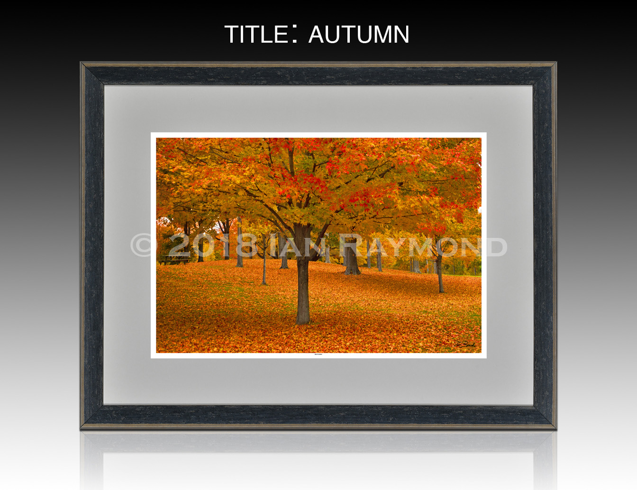
Photo 1

Slide 3

Photo 2

Slide 4
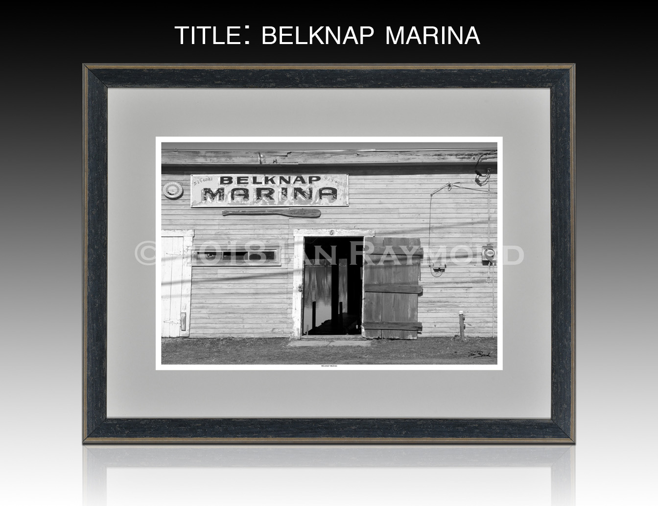
Photo 3

Slide 5
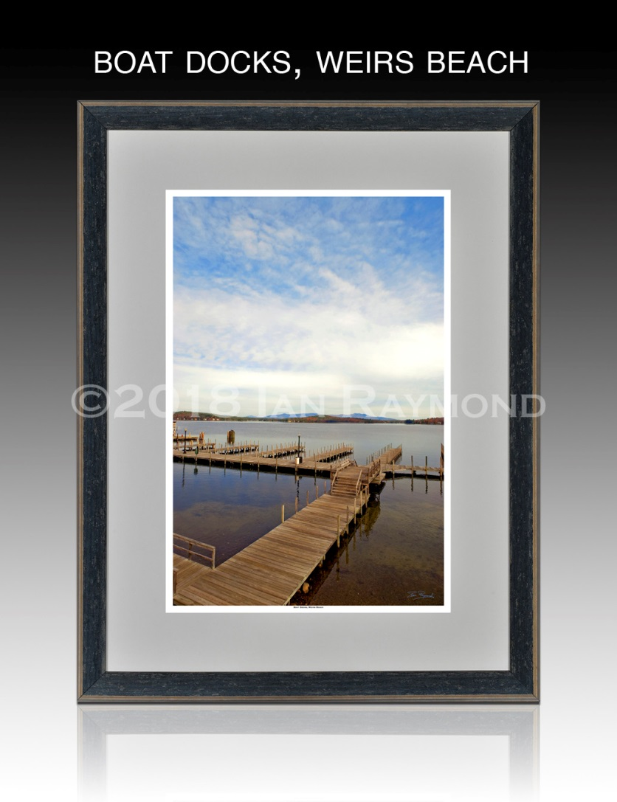
Photo 4

Slide 6
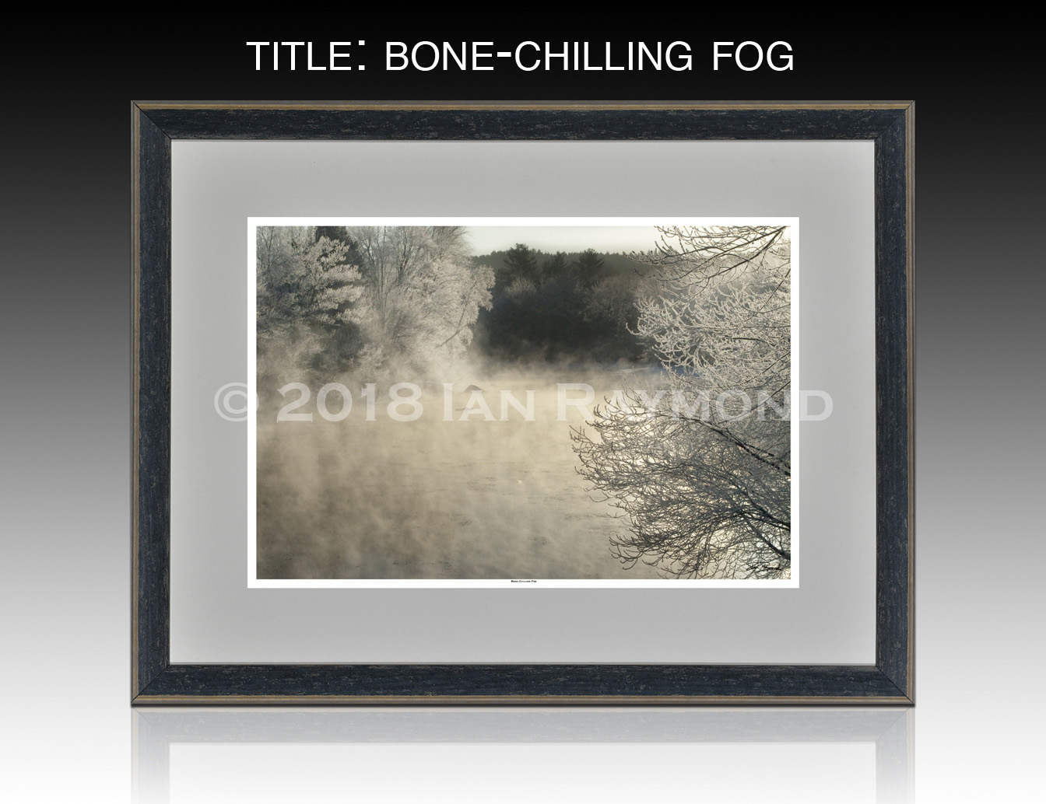
Photo 5

Slide 7
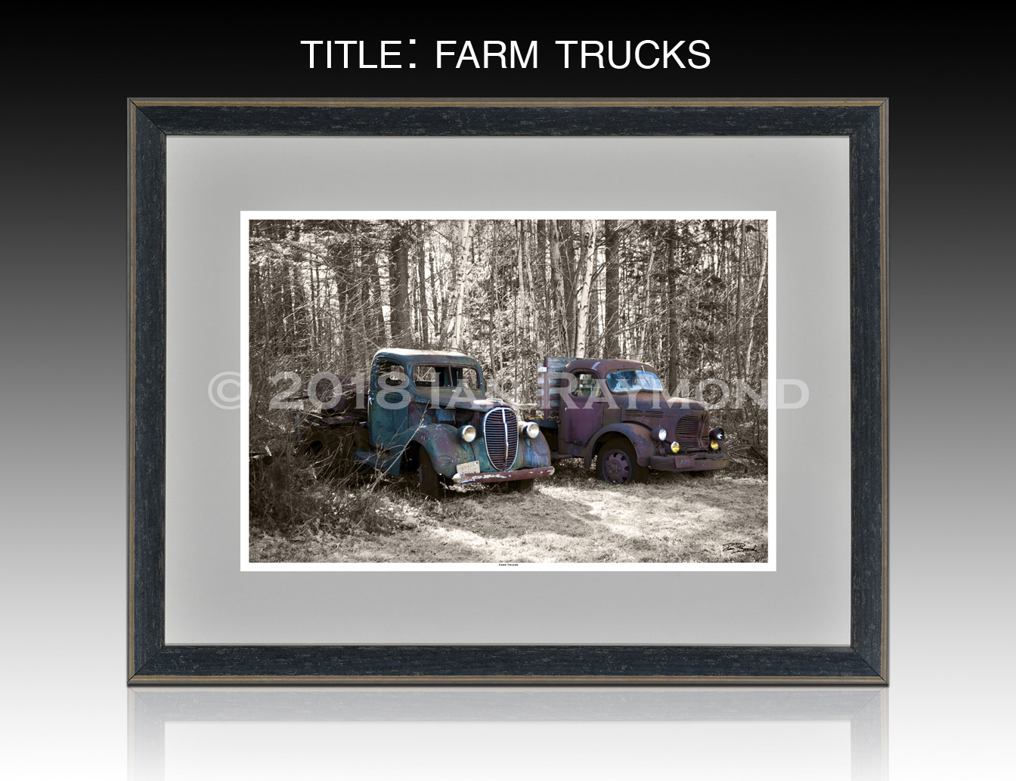
Photo 6

Slide 8
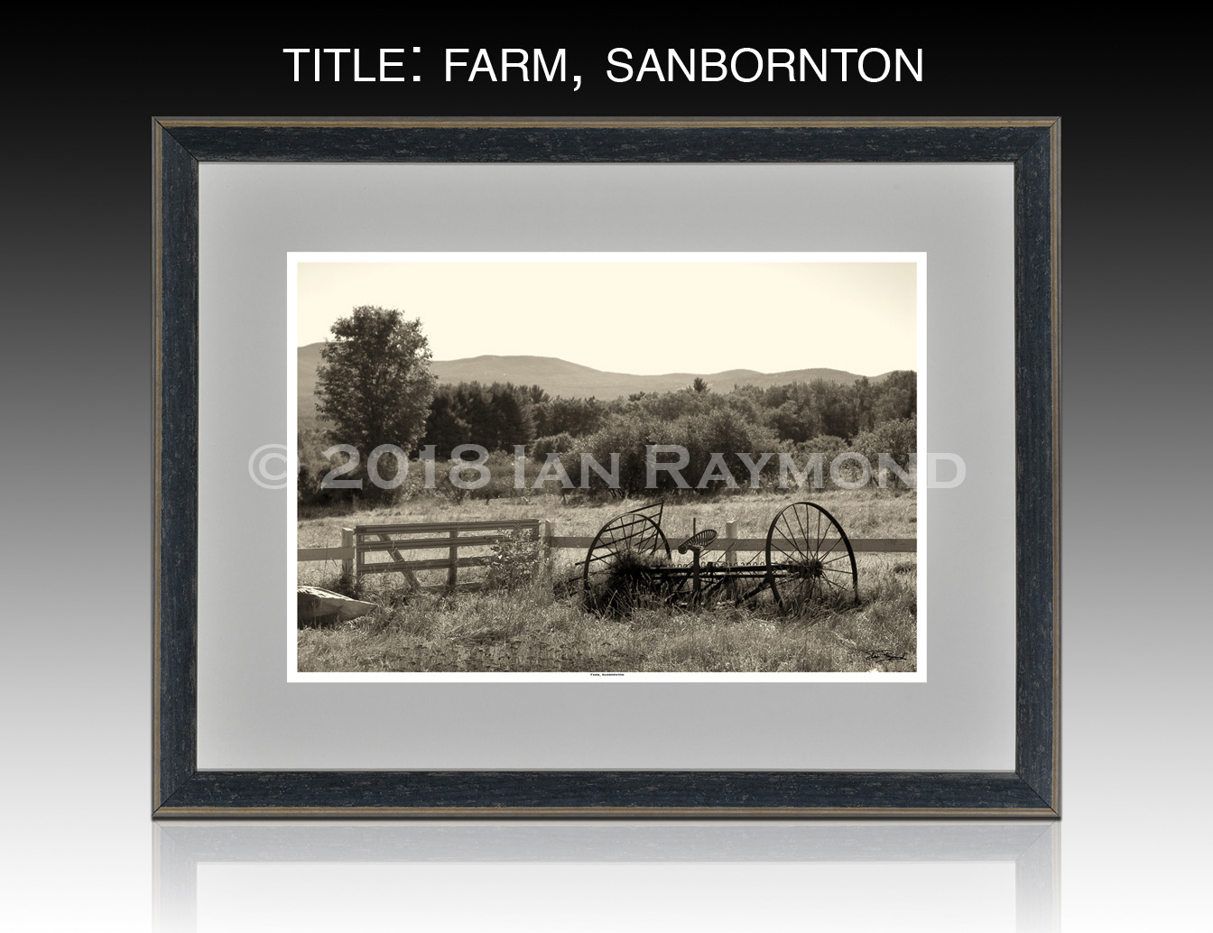
Photo 7

Slide 9
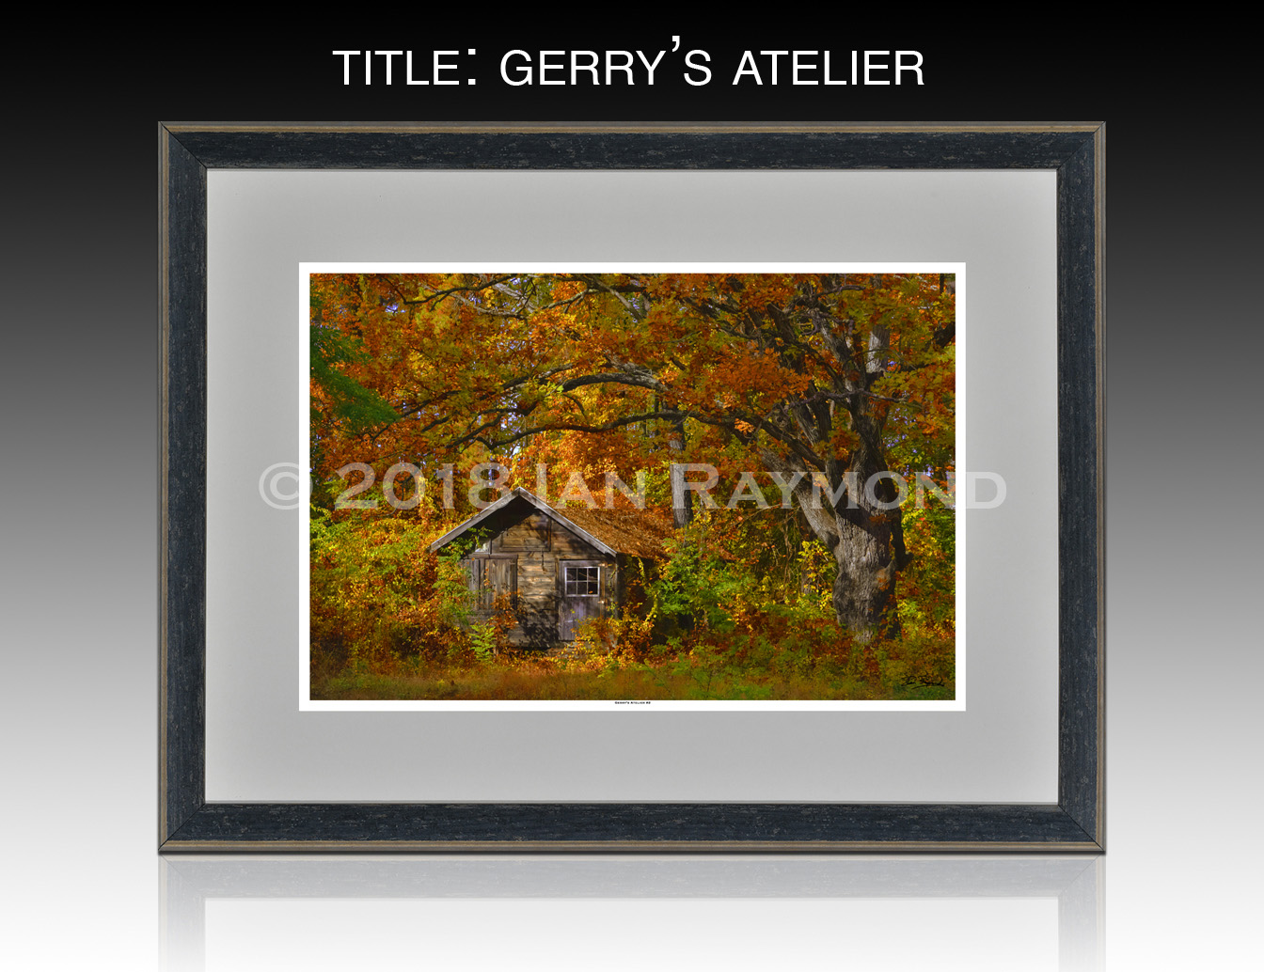
Photo 8

Slide 10
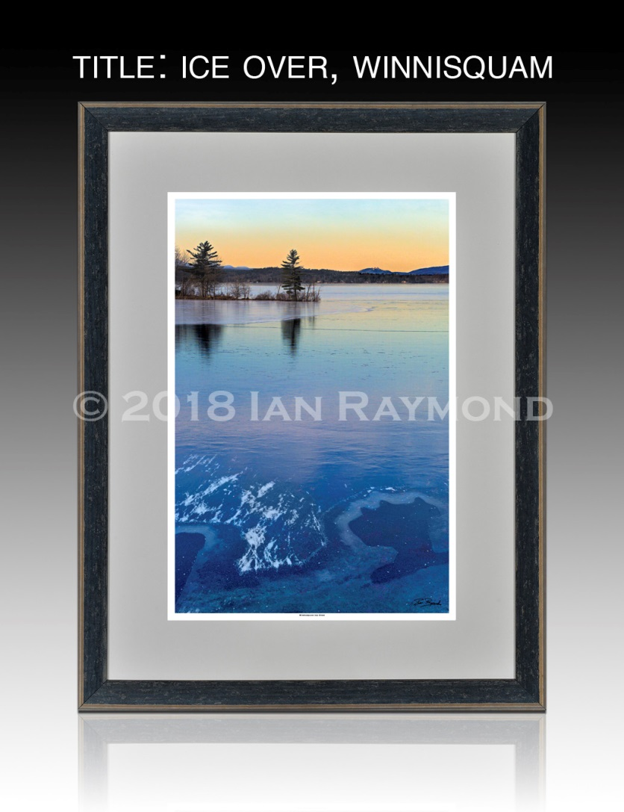
Photo 9

Slide 11

Photo 10

Slide 12
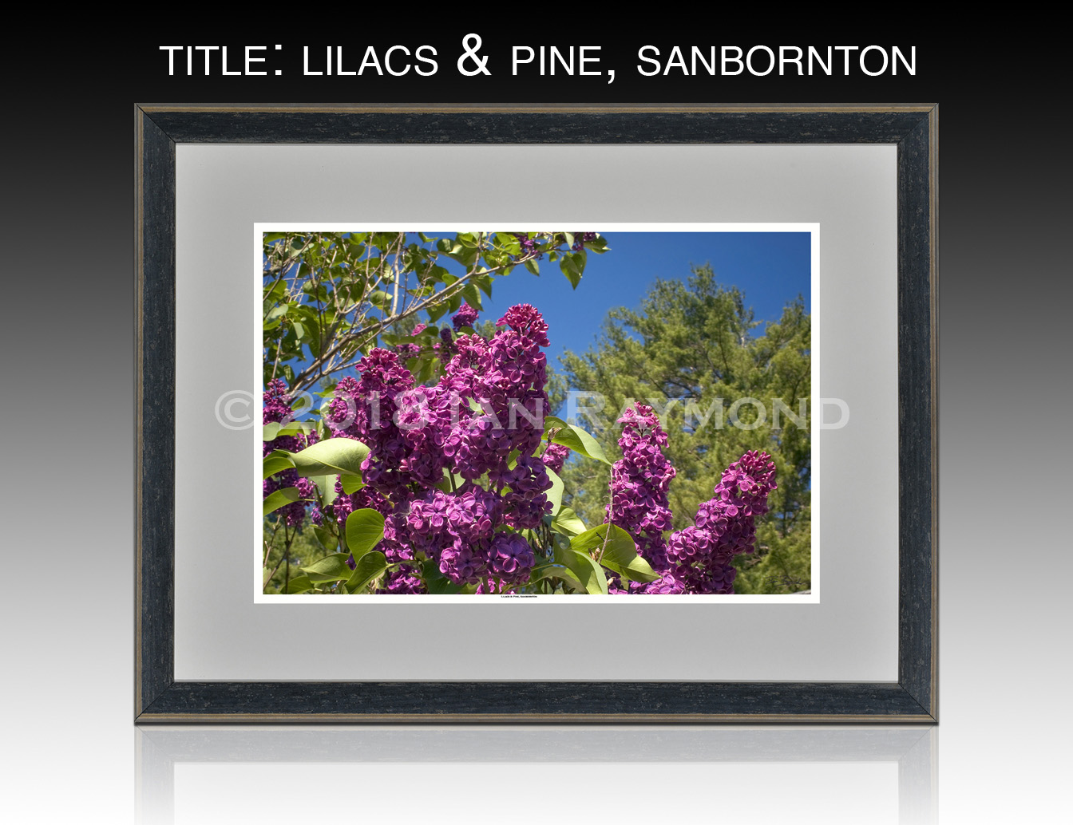
Photo 11

Slide 13
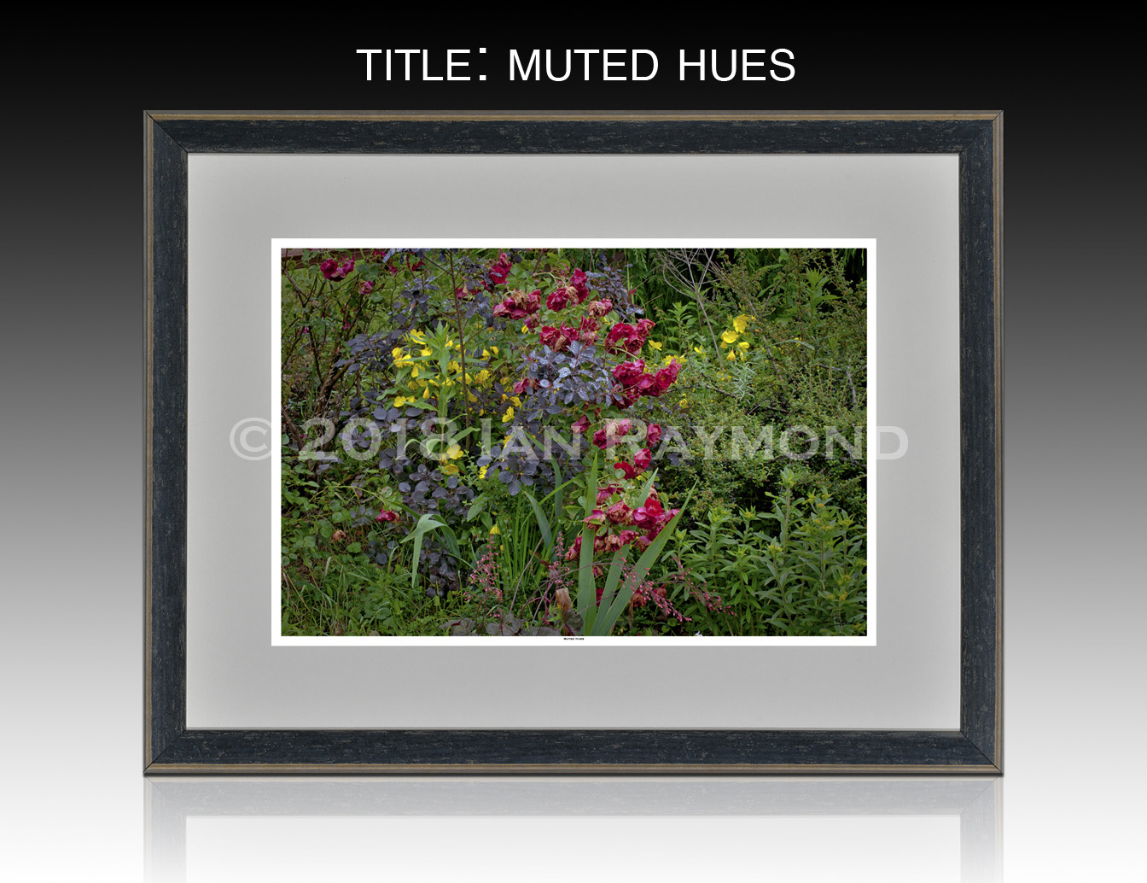
Photo 12

Slide 14
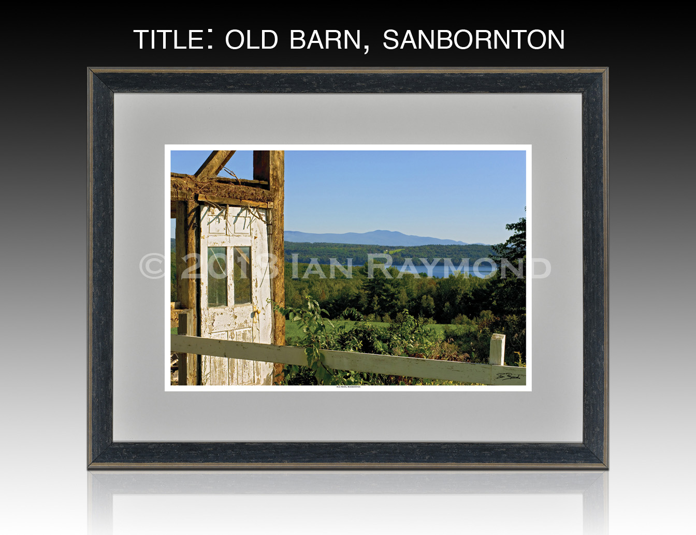
Photo 13

Slide 15
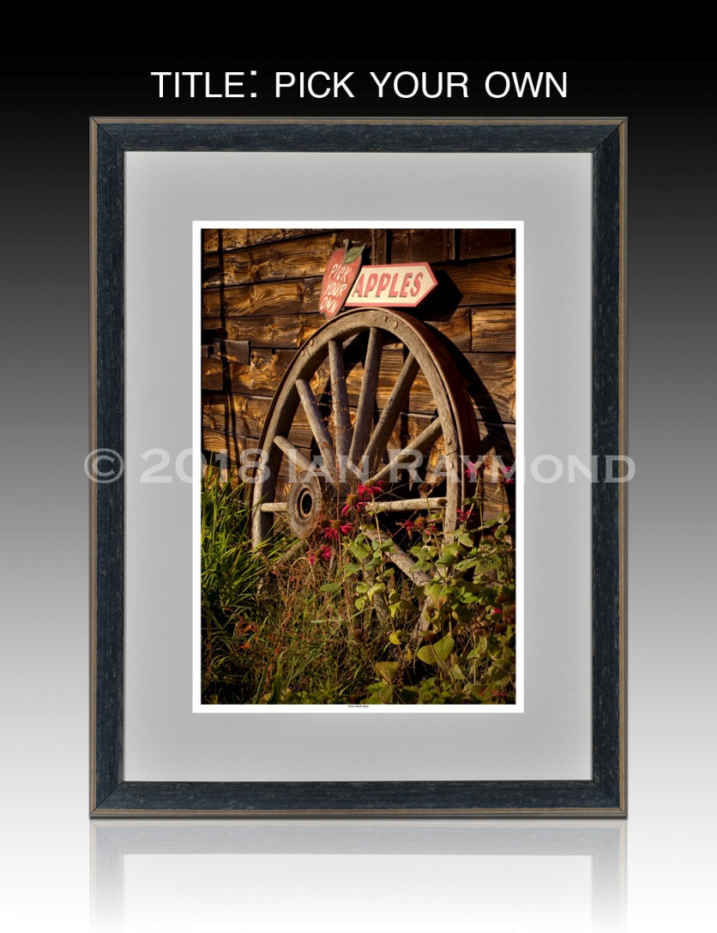
Photo 14

Slide 16
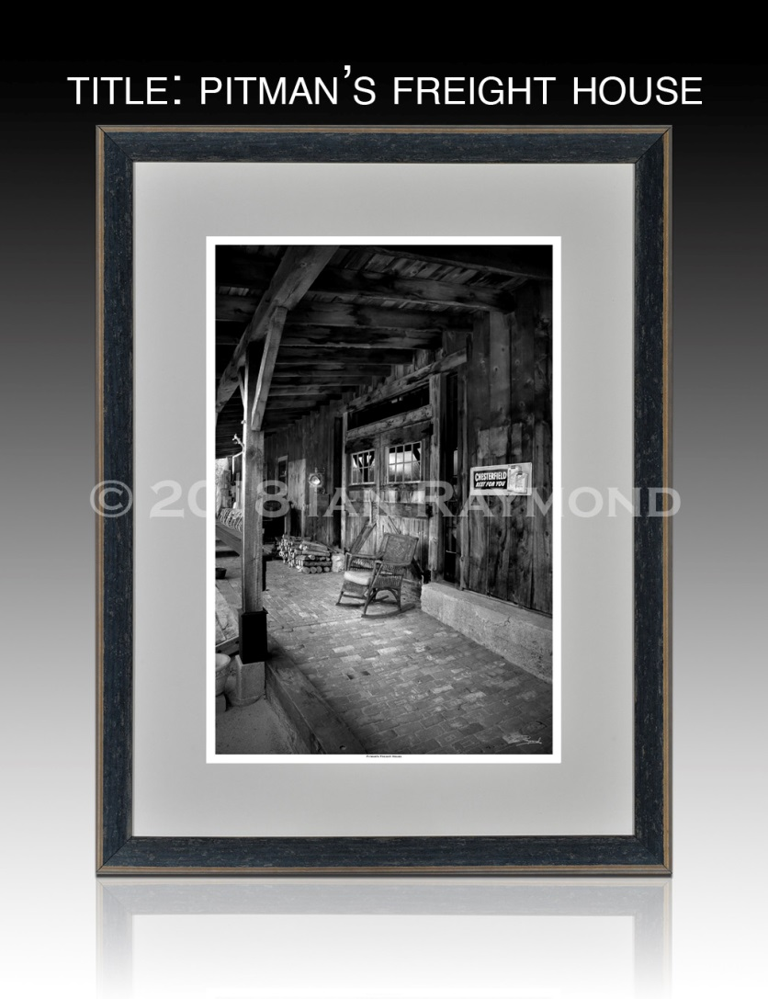
Photo 15

Slide 17
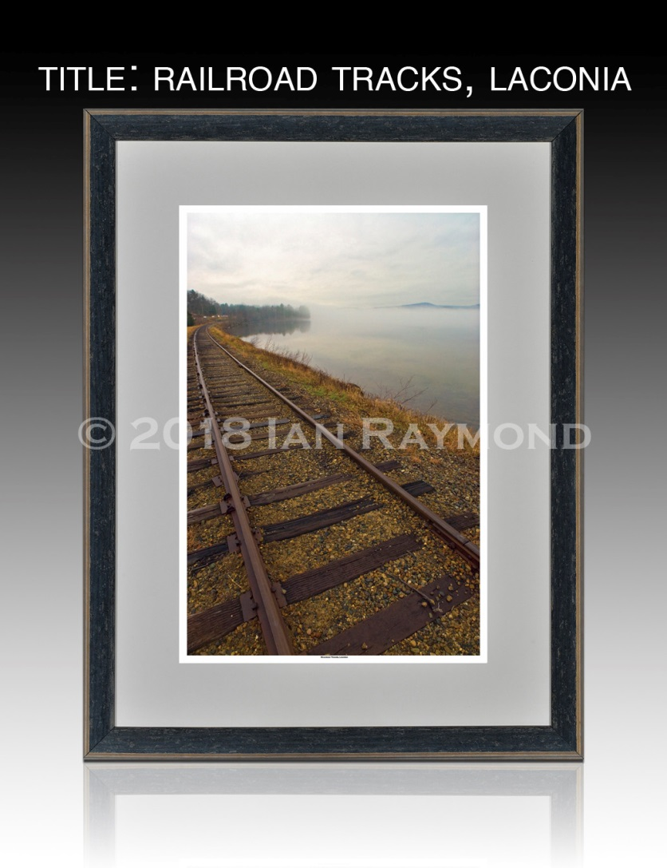
Photo 16

Slide 18
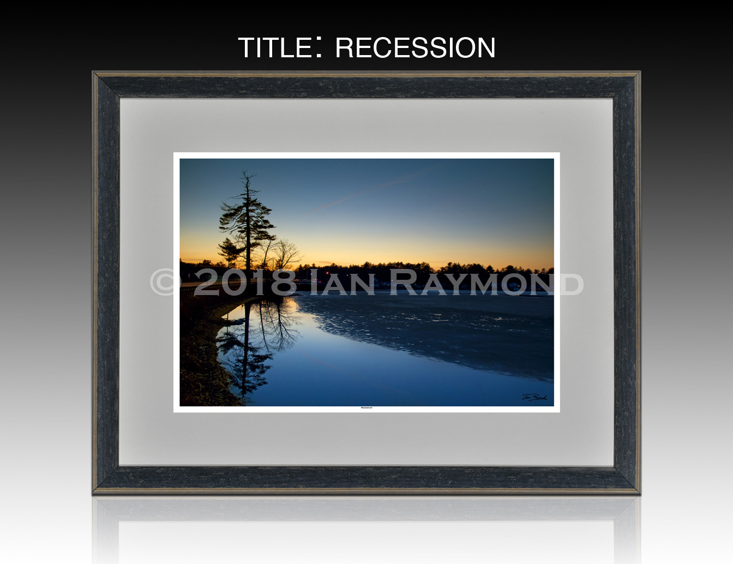
Photo 17

Slide 19
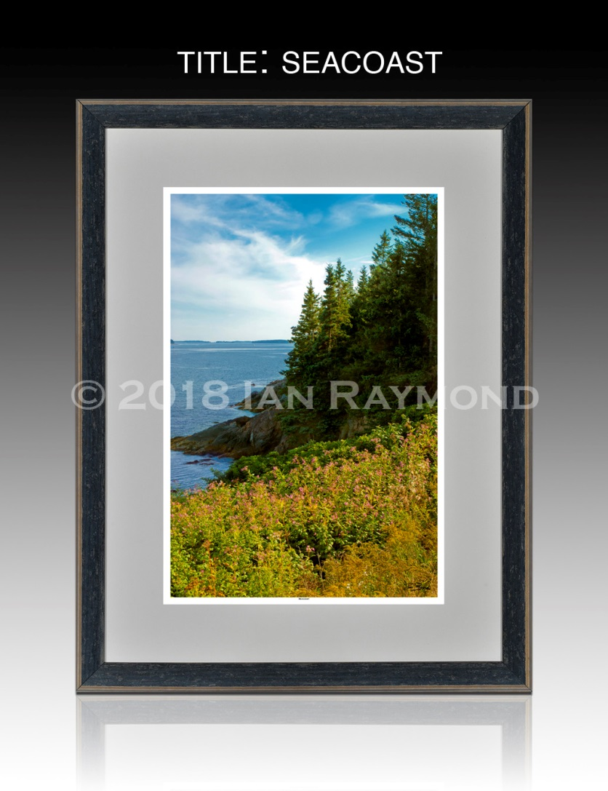
Photo 18

Slide 20
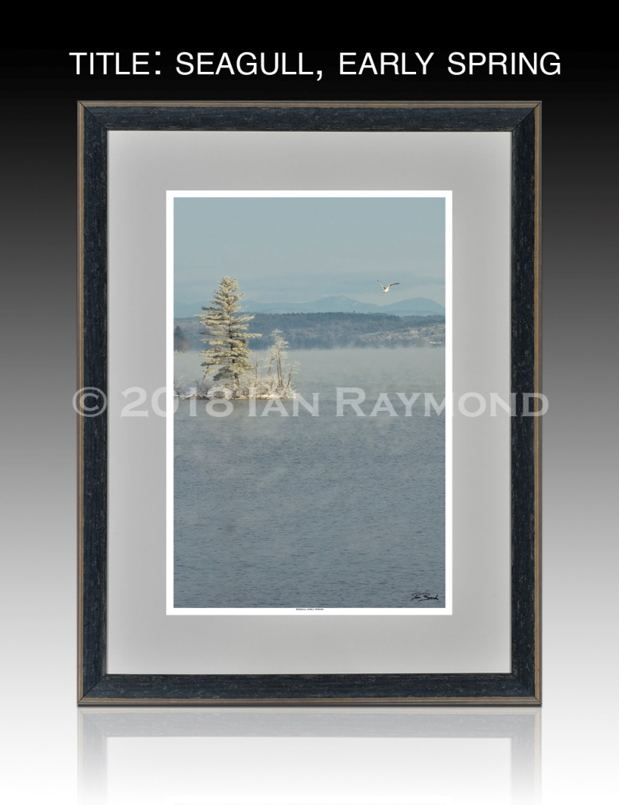
Photo 19

Slide 21
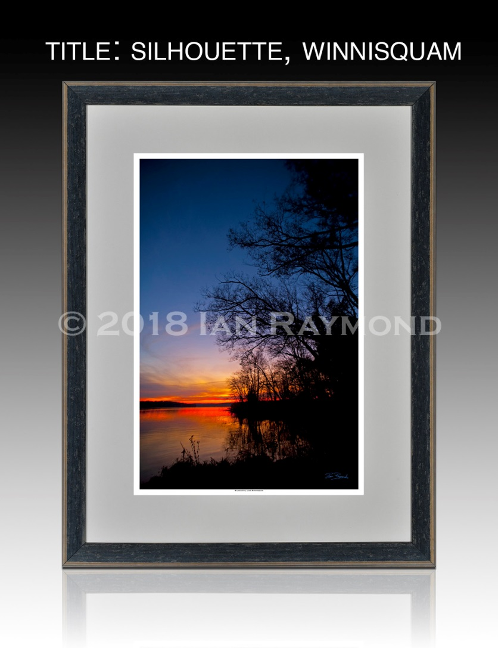
Photo 20

Slide 22
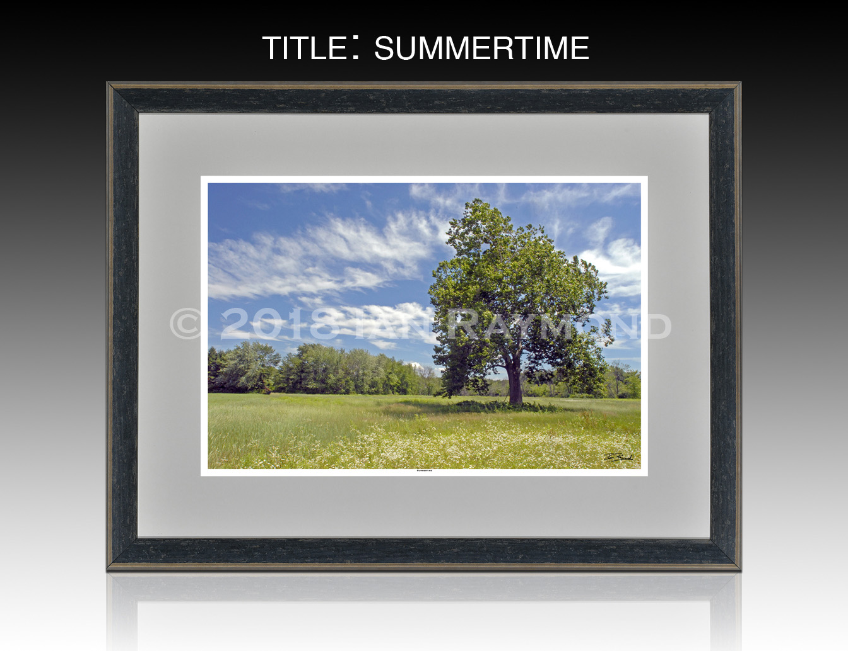
Photo 21

Slide 23
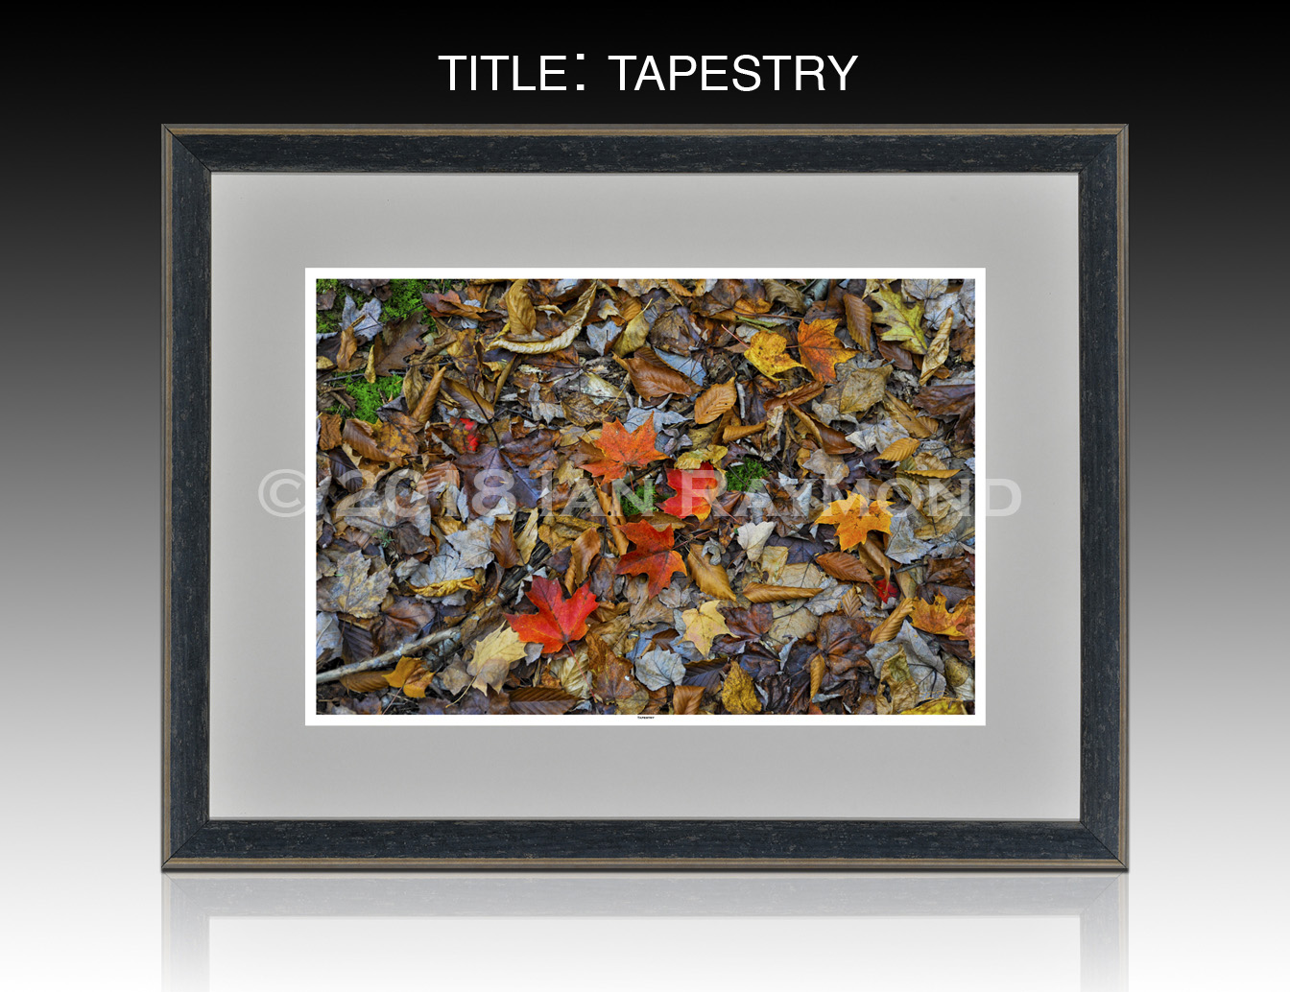
Photo 22

Slide 24
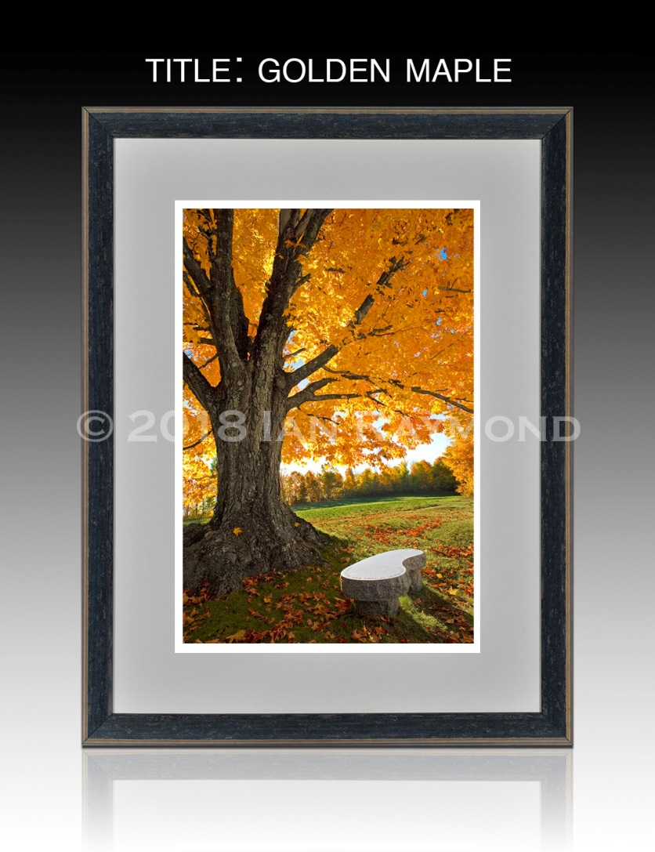
Photo 23

Slide 25
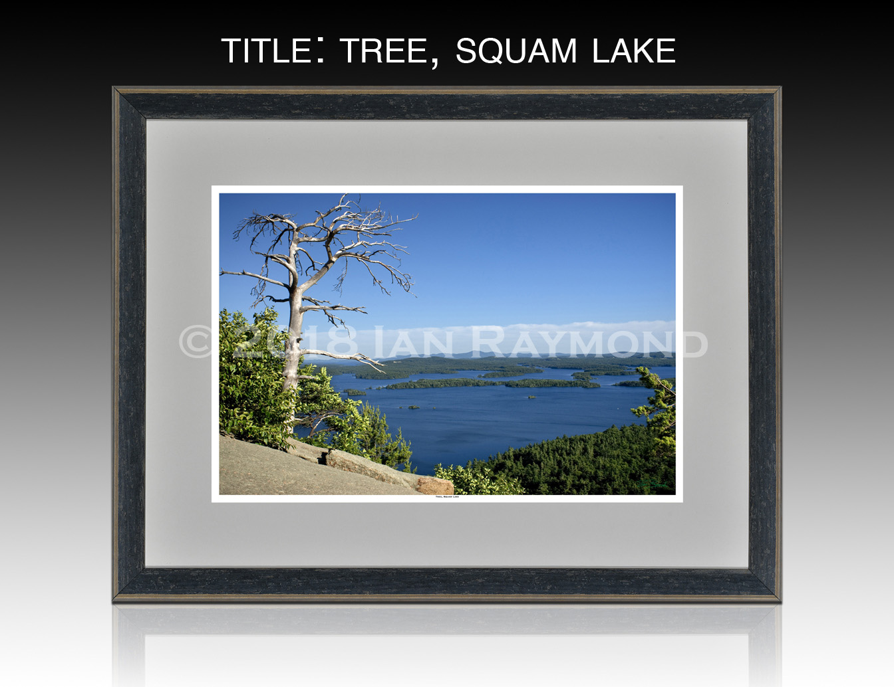
Photo 24

Slide 26
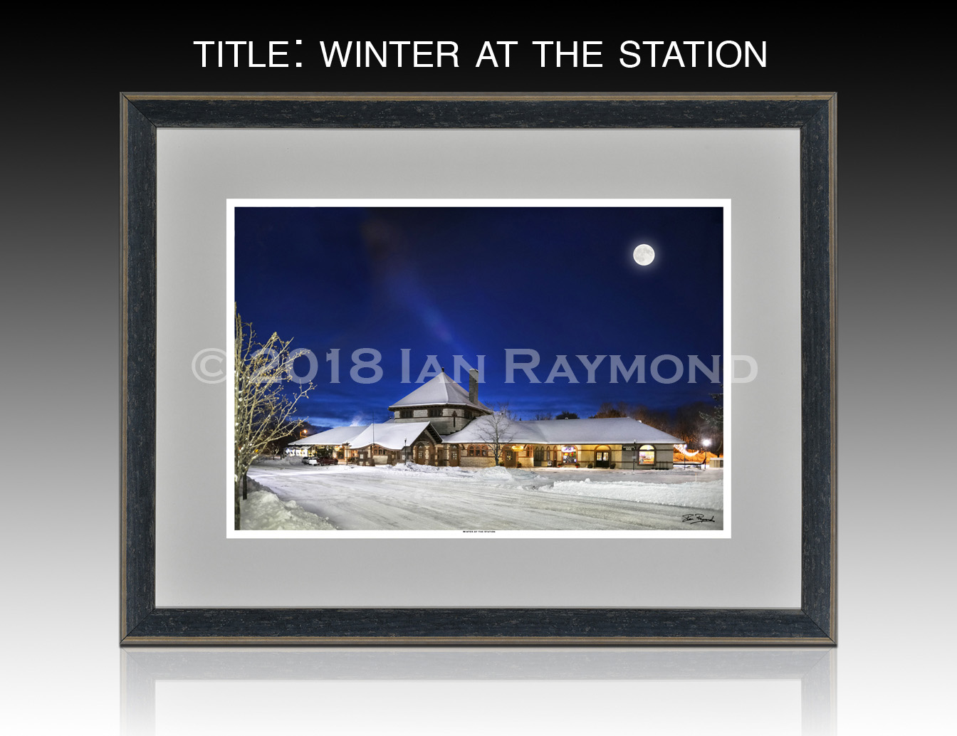
Photo 25

Slide 27
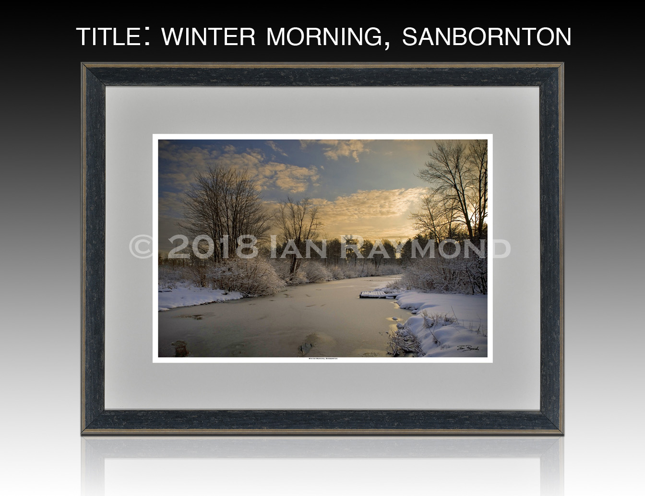
Photo 26

Slide 28
About the Artist
Ian owns Raymond Photography in Laconia. His studio specializes in commercial, architectural, and industrial photography; as well as fine art portraiture and landscapes, many of which are displayed in homes and businesses throughout New England. His love of landscapes is closely tied to his work as an environmental activist. “In my travels I have come to truly appreciate the beauty that surrounds us, and how important the natural environment is to our quality of life. It is my hope that my photographs will serve not only as an historical record of picturesque landscapes, but also as an inspiration to other conservation-minded individuals to preserve what we have been blessed with.”
In addition to his photography, Ian also writes for magazines, has served as a state representative, and works on several committees and with nonprofit organizations on renewable energy issues. Please visit his website, www.raymondphoto.com

